Slide 1
Vehicle Loan Default Prediction
Shicheng Chen

Slide 2
Problem Statement & Objective
Problem: Financial institutions need to identify potential defaulters before loan approval
Objective: Build a predictive model to classify good vs. bad borrowers
Business value: Reduce default rates, optimize lending decisions

Slide 3
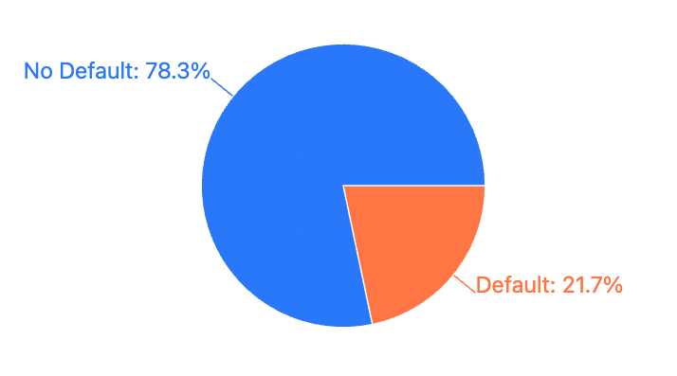
Dataset Overview
Dataset size: 233,154 rows and 42 columns
Data duration: 3 months (03-08-2018 to 31-10-2018)
Key features: Loan details, borrower information, credit history
Target variable: loan_default (binary classification problem)

Slide 4
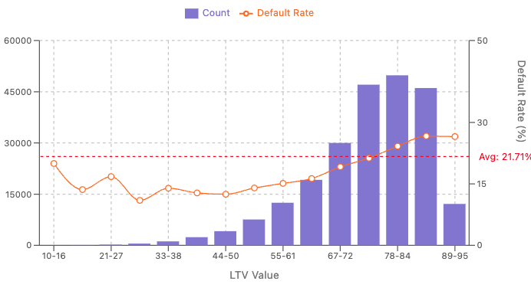
Feature Exploration: LTV
Loan-to-Value (LTV): the amount of a loan compared to the vehicle's value
Default rates show a positive correlation with LTV values.
Correlation weakens at extreme LTV ranges (<40 and >85) due to limited sample sizes in these segments.

Slide 5
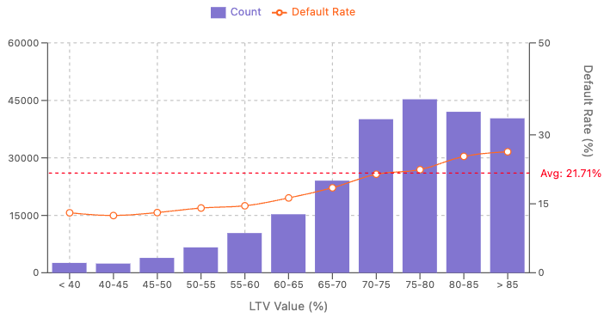
LTV vs Default Rate: Risk Prediction (Improved Visualization)
Observations:
Strong positive correlation with default rate
Lowest default: <40% LTV
Highest default: >85% LTV
Reasons:
Higher LTV increases payment burden
Lower equity reduces borrower’s commitment

Slide 6
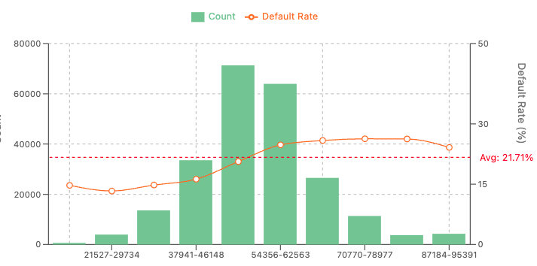
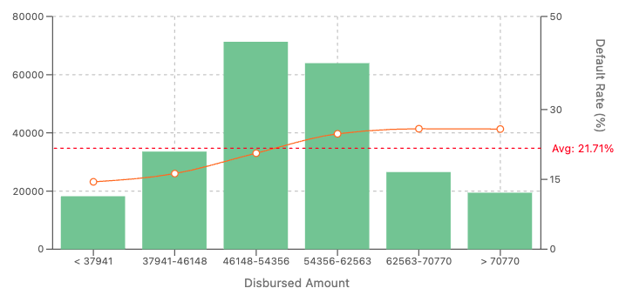
Loan Amount vs. Default Risk Analysis
Feature:
Disbursed Loan Amount
Observation:
Highest loan volume: $46K-$63K
Default rate grows: small (15%) → large loans (25%)
Reasons:
Small loans: affordable repayments
Large loans: heavy repayment burdens; higher financial stress

Slide 7
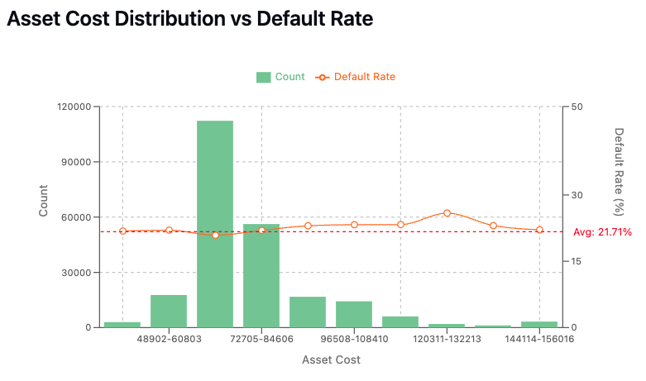
Asset Cost vs. Default Rate – Feature Effectiveness Evaluation
Observation:
Predictive value limited due to uneven distribution.
Why This Happens:
Limited samples in extreme asset ranges can skew predictability.

Slide 8
The Importance of ID Features
Decision Pattern Analysis:
Branch/Employee IDs reveal location patterns and decision tendencies
Geographic Factors:
State IDs and Pincodes capture economic conditions, regulatory frameworks, and cultural variations
Product Quality:
Manufacturer and Supplier IDs identify reliability variations

Slide 9
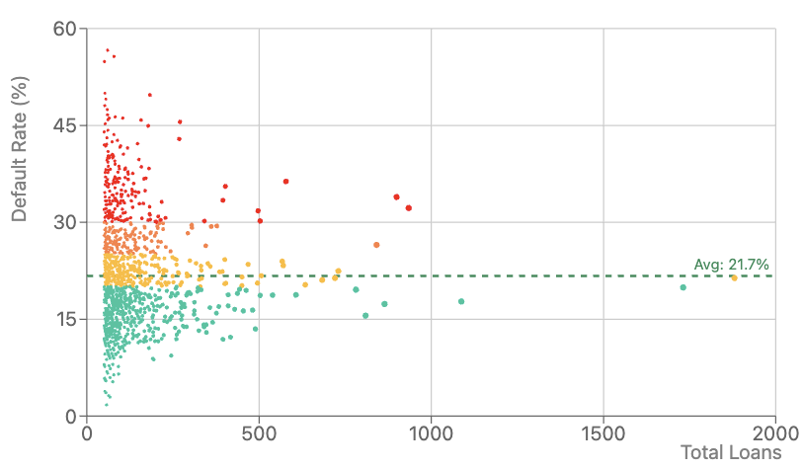
Geographic Loan Default Analysis: Pincode Impact
Most pincodes having fewer than 50 loans
Only 21 pincodes have more than 500 loans
Default rates vary significantly by pincode, even for areas with sufficient data
Pincode 3000 has the highest default rate (36.3%) among high-volume areas
Pincode 1794 has the lowest default rate (15.6%) among high-volume areas

Slide 10
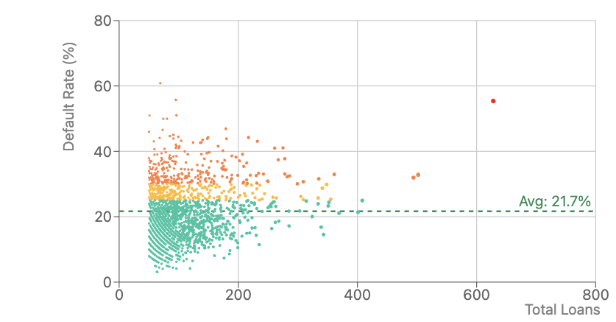
Human Factor in Loan Defaults: Employee ID Performance Metrics
Employee performance varies dramatically
Employee 2546 processed a high volume (628 loans) but has an alarmingly high default rate (55.4%)
Some employees consistently maintain low default rates despite high volumes

Slide 11
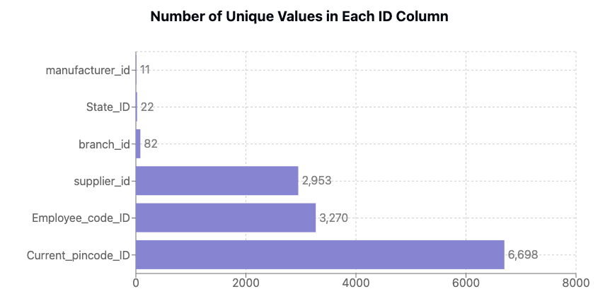
High Cardinality Features
Problem: One-hot encoding becomes infeasible
too many columns, memory issues.
Solutions:
Smoothed target encoding
replaces categories with regularized target statistics
CatBoost
directly handles categorical features

Slide 12
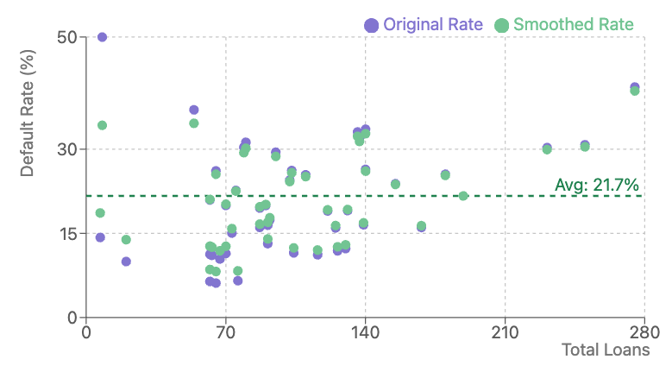
Smoothed Target Encoding
Smoothed target encoding
replaces categorical variables with a blend of the target variable's mean for that category and the global mean
Original and smoothed values converge as sample size increases
Minimal smoothing effect on larger samples
Use only training set default rates to prevent data leakage

Slide 13
Feature engineering
Handling Missing values:
Employment.Type: filled missing values with Unknown
Created features
Age at Disbursal:
Captures customer age at loan disbursement
Disbursal Day:
Identifies potential cyclical patterns in loan disbursement timing
Note: These are select examples from a total of 105 engineered features created for the model.

Slide 14
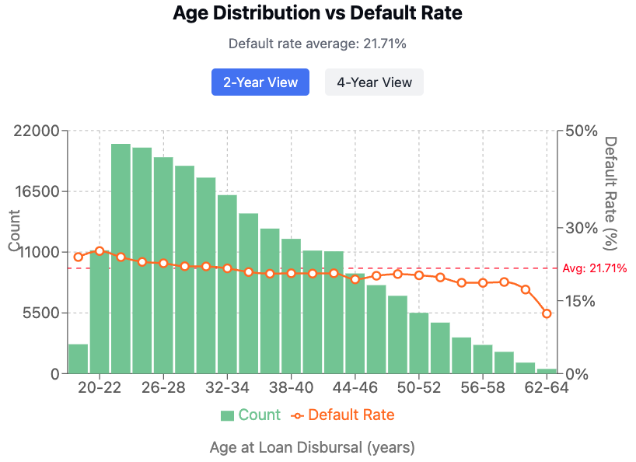
Age Distribution vs Default Rate
Feature: Borrower age (20-64 years)
Key Points:
Strong inverse relationship: default rates decrease with age
Youngest borrowers show highest risk (25%)
Factors:
Financial stability increases with age
Younger borrowers face income uncertainty
Older borrowers have more debt management experience

Slide 15
Modeling Approach
Data split:
First 80% for training, last 20% for testing
Model:
CatBoost
Evaluation:
AUC-ROC metric on held-out test data to handle class imbalance
Ensemble:
CV Ensemble
Mean Ensemble
Stacking Ensemble

Slide 16
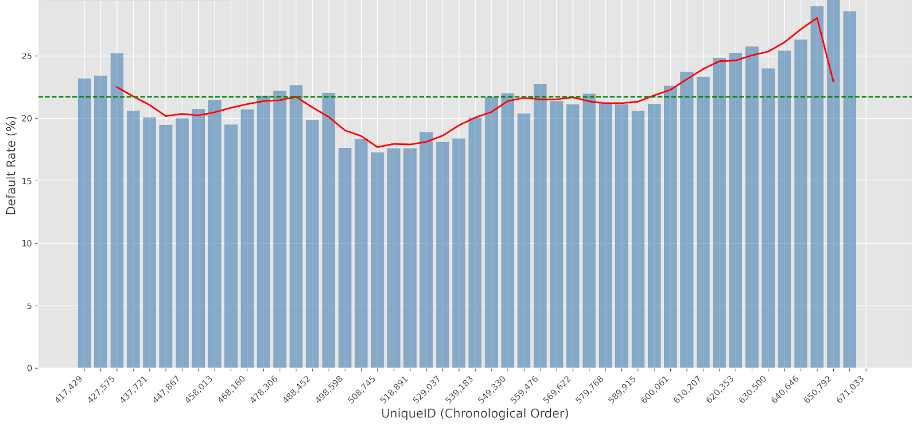
Avoiding Data Leakage by Using Time-Based Train-Test Split
Initial approach: 80/20 stratified split
Discovery: UniqueID ranked as top 5 important feature
Investigation: UniqueID appears time-ordered with visible patterns
Problem: Information leakage as model learns temporal patterns
Solution: Changed to chronological
split (first 80% for training, last 20%
for testing)

Slide 17
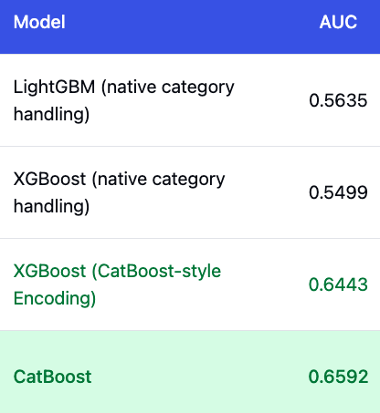
CatBoost Superiority for High Cardinality Categorical Features
CatBoost outperforms other models (LightGBM, XGBoost) when processing high-cardinality categorical features
Achieves superior AUC (0.6592) compared to competitors
Remains effective even when others use target encoding or native category handling
Recommended as the optimal choice for datasets with important categorical variables

Slide 18
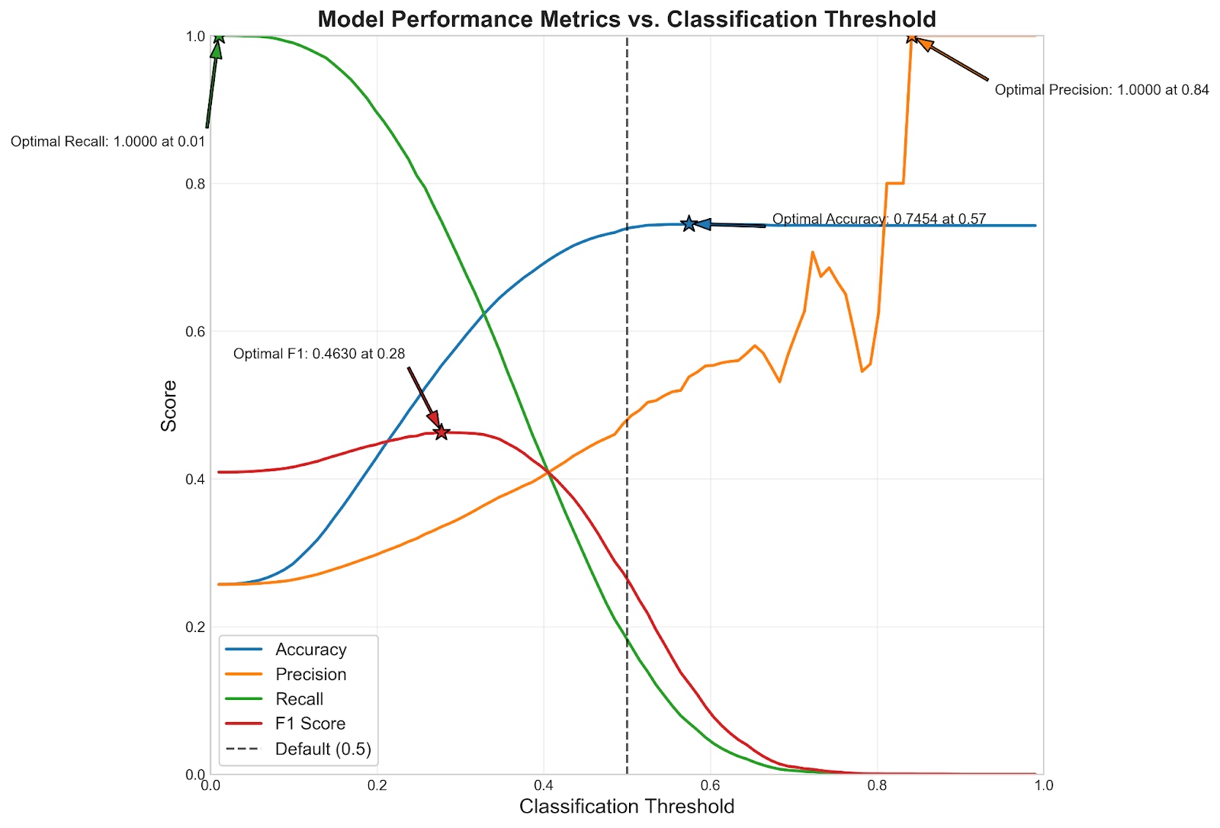
Why Common Metrics Mislead in Imbalanced Classification
Accuracy
Misleads with imbalanced data
Example: With 79% positive cases, predicting "always positive" yields 79% accuracy despite zero insight
Recall, Precision, F1
Threshold-dependent values
The graph shows optimal thresholds vary widely:
F1 optimal at 0.28
Accuracy optimal at 0.57
Precision optimal at 0.84
Recall optimal at 0.01

Slide 19
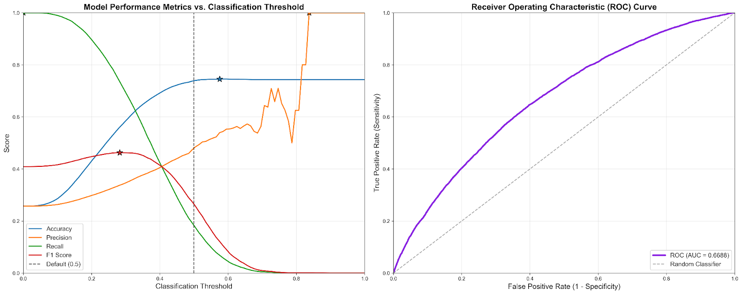
Why AUC-ROC Is Superior for Imbalanced Classification
AUC-ROC Advantages
Threshold-independent evaluation
Measures performance across all possible thresholds
Not affected by class imbalance unlike accuracy, precision, recall
Left Graph Problem
Shows how threshold choice drastically affects traditional metrics
No single optimal threshold satisfies all metrics simultaneously

Slide 20
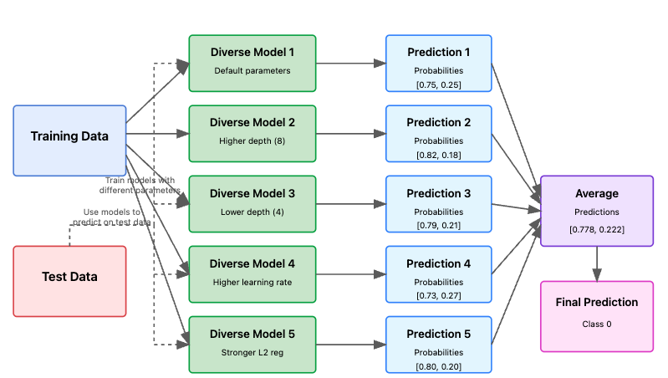
Diverse Model Ensemble for Improved Prediction Accuracy
Multiple diverse models with different parameters trained on the same data, then averaged to produce more robust final predictions.

Slide 21
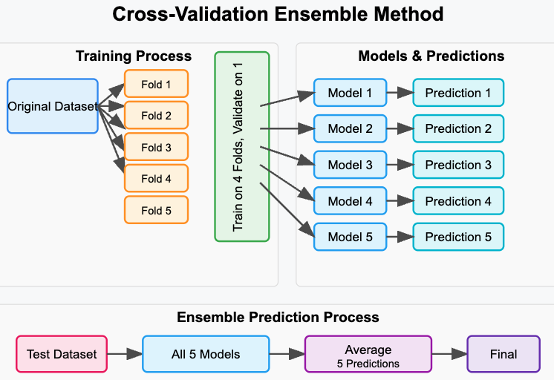
Cross-Validation Ensemble
A technique combining predictions from multiple models trained on different data splits to improve performance and reliability.

Slide 22
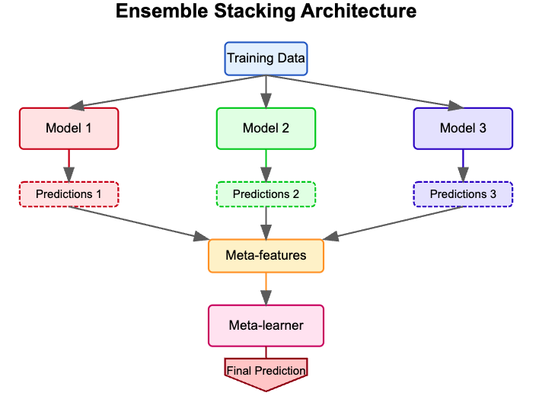
Ensemble Stacking Architecture
Multiple base models make predictions that become meta-features for a meta-learner, which produces the final prediction.

Slide 23
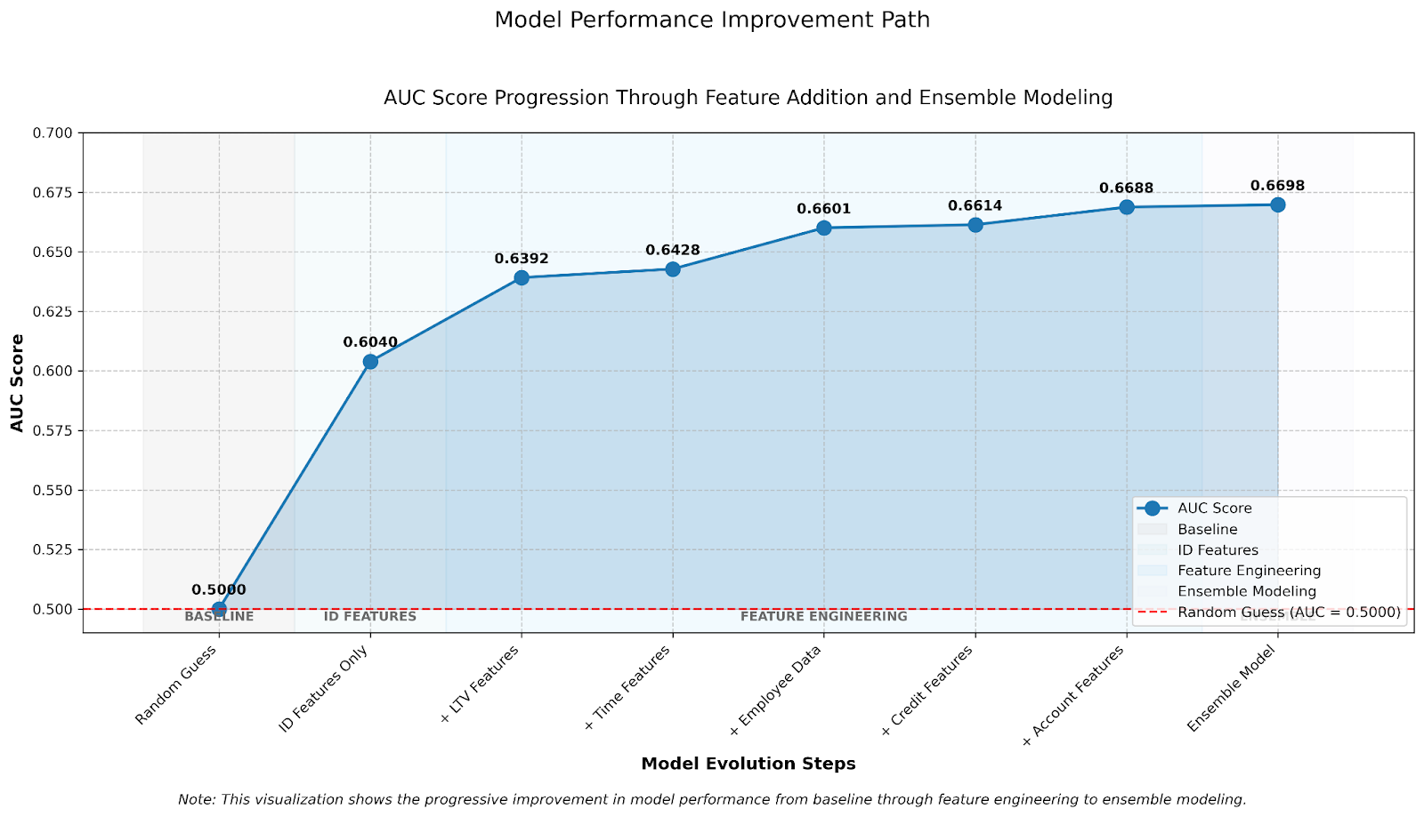
Model Performance Improvement Path
ID features provide foundation (+10.4%)
LTV features offer significant value
Diminishing returns after employee data
Ensemble modeling provides modest final lift
CV ensemble perform best
Harnesses model diversity to create a robust predictor with lower overall variance.

Slide 24
Top Features Explained
LTV: Higher ratios indicate less borrower equity, increasing default risk during property value declines.
Employee Code: Loan officers vary in risk assessment skills and customer segments served.
Supplier ID: Different origination channels attract varying customer risk profiles.
Employment LTV Risk: Self-employed borrowers face income volatility unlike salaried employees.
Branch ID: Regional economic conditions and lending practices create geographical default patterns.

Slide 25
Employee Code ID: Hidden Predictive Power
Key Observation
EmployeecodeID is unexpectedly predictive of vehicle loan defaults
Outperforms traditional predictors (branch_id, supplier_id, geographic data)
Only used for logging disbursements, not approval decisions
Why This Happens
Employee Specialization: Certain employees may handle specific risk segments
Hidden Correlations: Employee IDs indirectly map to customer profiles or loan types
Training Differences: Newer employees vs. experienced ones might handle different loan types or have different levels of scrutiny
Fraud Indicator: Strong correlation with particular employees could indicate potential fraud or policy violations

Slide 26
Conclusion
ID features unexpectedly delivered strongest predictive power
LTV ratio confirmed as fundamental default risk indicator
CatBoost model outperformed competitors
Employee Code ID revealed surprising correlation with defaults
Ensemble approach maximized model performance
AUC-ROC proved most reliable metric for imbalanced classification

Slide 27
Thank You

Slide 28
CatBoost & Outliers
Why CatBoost Handles Outliers Well
Ordered Boosting: Uses permutation-driven approach where sample influence depends on position
Gradient Dilution: Outlier impact varies across trees as position changes in each permutation
Tree-Based Splits: Makes decisions based on thresholds, not distances or absolute values
When to Filter Outliers Anyway
Data errors (truly invalid values)
Regulatory/business requirements
Key Insight
"CatBoost's permutation-based learning inherently dilutes outlier influence by randomizing their position and impact across multiple trees."

Slide 29
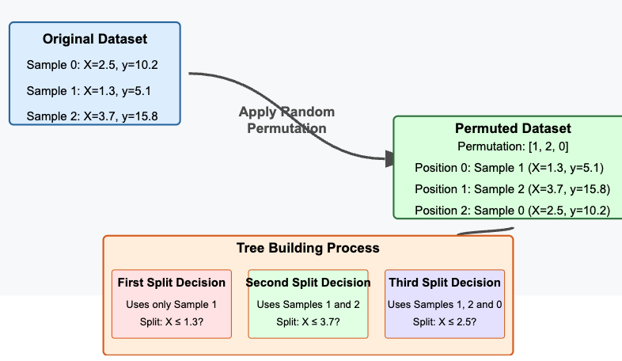
CatBoost Tree Building with Permutation
Original Dataset Box
Random Permutatio
Tree Building Process:
First split only uses Sample 1
Second split uses Samples 1 and 2
Third split uses all three samples: 1, 2, and 0

Slide 30
UniqueID
UniqueID serves as customer identifier
IDs correlate with chronological order
Lower ID numbers indicate earlier customers
Correlation confirmed by DisbursalDate data

Slide 31
loan_default
Failure to pay first monthly loan installment by due date
EMI = Equated Monthly Installment (fixed payment amount)
Contains both principal and interest components
Early default signals potential repayment issues

Slide 32
Flags
Aadhar_flag
Tracks if customer provided Aadhar
Aadhar card is India's unique biometric identification document issued by the Unique Identification Authority of India (UIDAI)
PAN_flag
The PAN card is an important tax identification document in India

Slide 33
sanctioned amount vs disbursed amount
DISBURSED.AMOUNT
This refers to the total amount that was actually paid out or transferred to you across all loans.
SANCTIONED.AMOUNT
This is the total amount that the lender has approved or agreed to lend across all your loans at the time of approval.
Imagine you're approved for a home renovation loan:
Sanctioned Amount: $50,000 (the bank approves this total amount)
Disbursed Amount: $48,500 (after deducting $1,500 in processing fees)

Slide 34
CURRENT.BALANCE
Total Principal outstanding amount of the active loans at the time of disbursement
this represents the total principal amount that remains unpaid on all active loans at a specific point in time.
Where principal amount = sum of money borrowed in a loan or invested
A negative CURRENT.BALANCE typically indicates that the borrower has paid back more than what was required at that point in time

Slide 35
INSTAL.AMT
PRIMARY.INSTAL.AMT:
Customer is the main borrower
Example
If you have Loan A with a monthly payment of $300
And Loan B with a monthly payment of $500
And both are loans where you are the primary borrower
Then your PRIMARY.INSTAL.AMT would be $800
SEC.INSTAL.AMT:
Customer is a co-applicant or guarantor

Slide 36
NEW.ACCTS.IN.LAST.SIX.MONTHS
This counts how many new loans the customer has taken in the 6 months before this loan was disbursed. Opening multiple new credit accounts in a short period can be a risk indicator, as it might suggest financial distress or poor planning.

Slide 37
DELINQUENT.ACCTS.IN.LAST.SIX.MONTHS
This counts how many loans the customer has defaulted on (missed payments) in the 6 months before disbursement. Recent delinquencies are strong negative indicators of creditworthiness.

Slide 38
AVERAGE.ACCT.AGE
This measures the average age or tenure of all loans the customer has had. Longer average account age generally indicates more experience managing credit and is typically viewed positively by lenders.

Slide 39
CREDIT.HISTORY.LENGTH
This measures how long the customer has been using credit, calculated from when they took their first loan. A longer credit history provides more data for lenders to assess reliability and is generally viewed positively.

Slide 40
NO.OF_INQUIRIES
This counts how many times the customer has applied for loans (resulting in credit checks). Multiple inquiries in a short period can suggest that the applicant is desperately seeking credit and may be a higher-risk borrower.

Slide 41
Modeling Approach --> wrong
Data split:
80% train, 20% test
using stratified sampling to preserve class distribution
Models:
Logistic Regression, Random Forest, XGBoost, LightGBM, and CatBoost
Hyperparameter optimization:
RandomizedSearchCV
Evaluation:
AUC-ROC metric on held-out test data to handle class imbalance

Slide 42
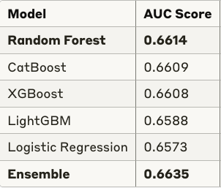
Model Performance Comparison
Ensemble selected:
+0.4% AUC over best single model
Key features:
Location, employee, supplier identifiers
Tradeoffs:
Random Forest highest AUC but 4× longer training time
Tree models consistently outperformed Logistic Regression
Ensemble approach improved performance by 0.4%

